Slide 1
SEL 2.0: Social-Emotional and Character Development, Purpose, Mindset, & Social Action
Maurice J. Elias, Ph.D.
Dept. of Psychology, Rutgers University
Director, Rutgers Social-Emotional and Character Development Lab
(www.secdlab.org) @SECDLab
Co-Director, The Academy for Social-Emotional Learning in Schools SELinSchools.org maurice.elias@rutgers.edu www.edutopia.org/profile/maurice-j-elias
Keynote, Rhode Island Education Vendor Fair,
Providence, RI, November 16, 2018

Slide 2
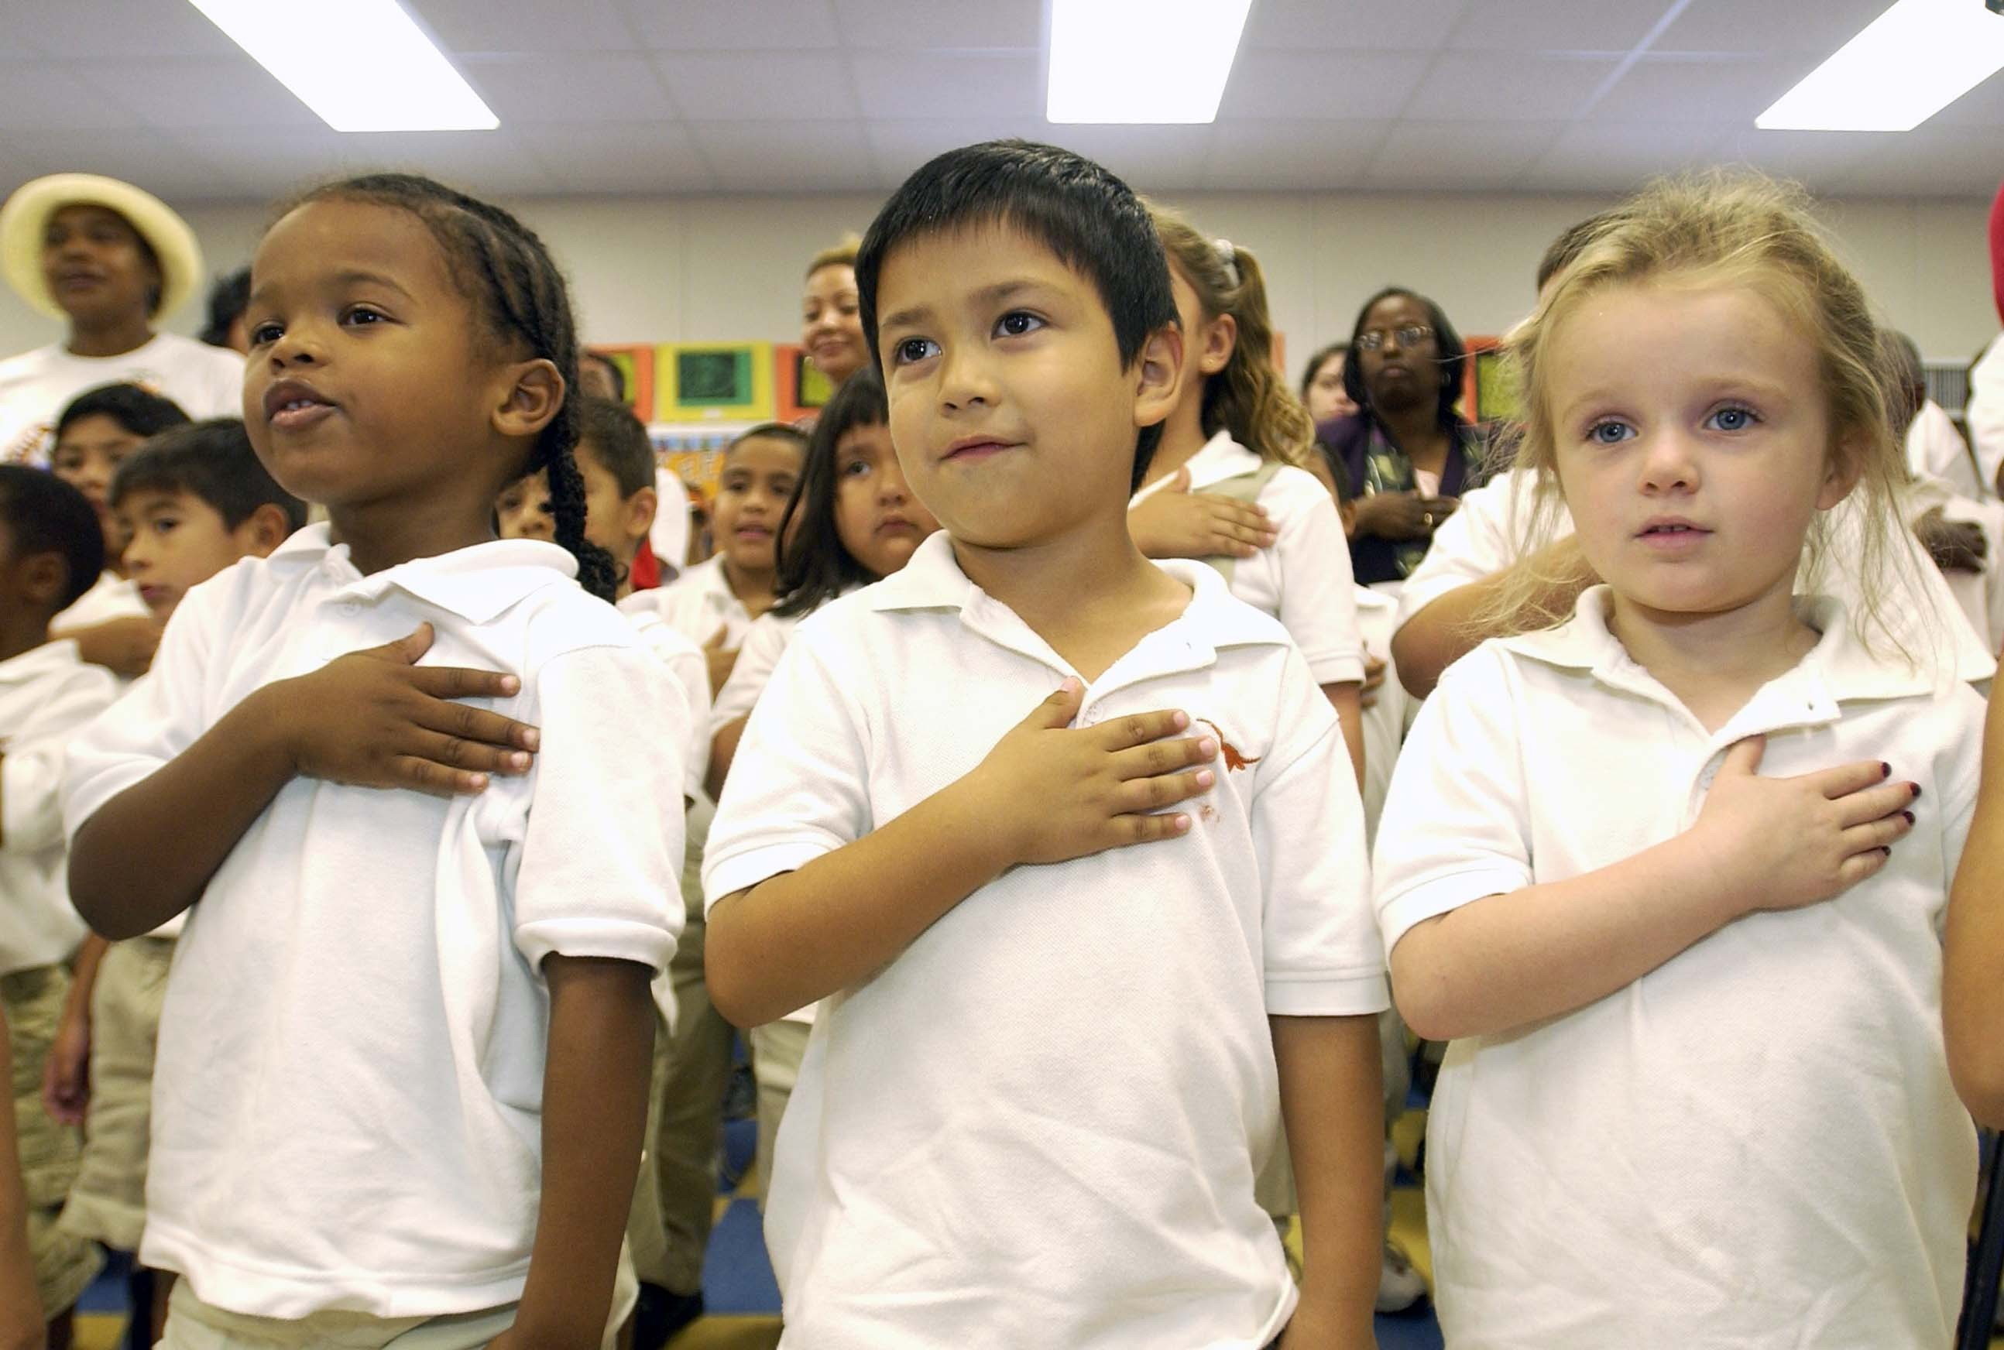

What is Needed to be College, Career, Community, & Life Ready… in 2028?
www.youtube.com/watch?v=uqZiIO0YI7Y

Slide 3
We are preparing our students for an uncertain future! But one constant will be the importance of caring interpersonal relationships, civil discourse, and a commitment to democratic citizenship and the
skills to enact it.

Slide 4

A person is a person through
other
persons.
–Bantu

Slide 5
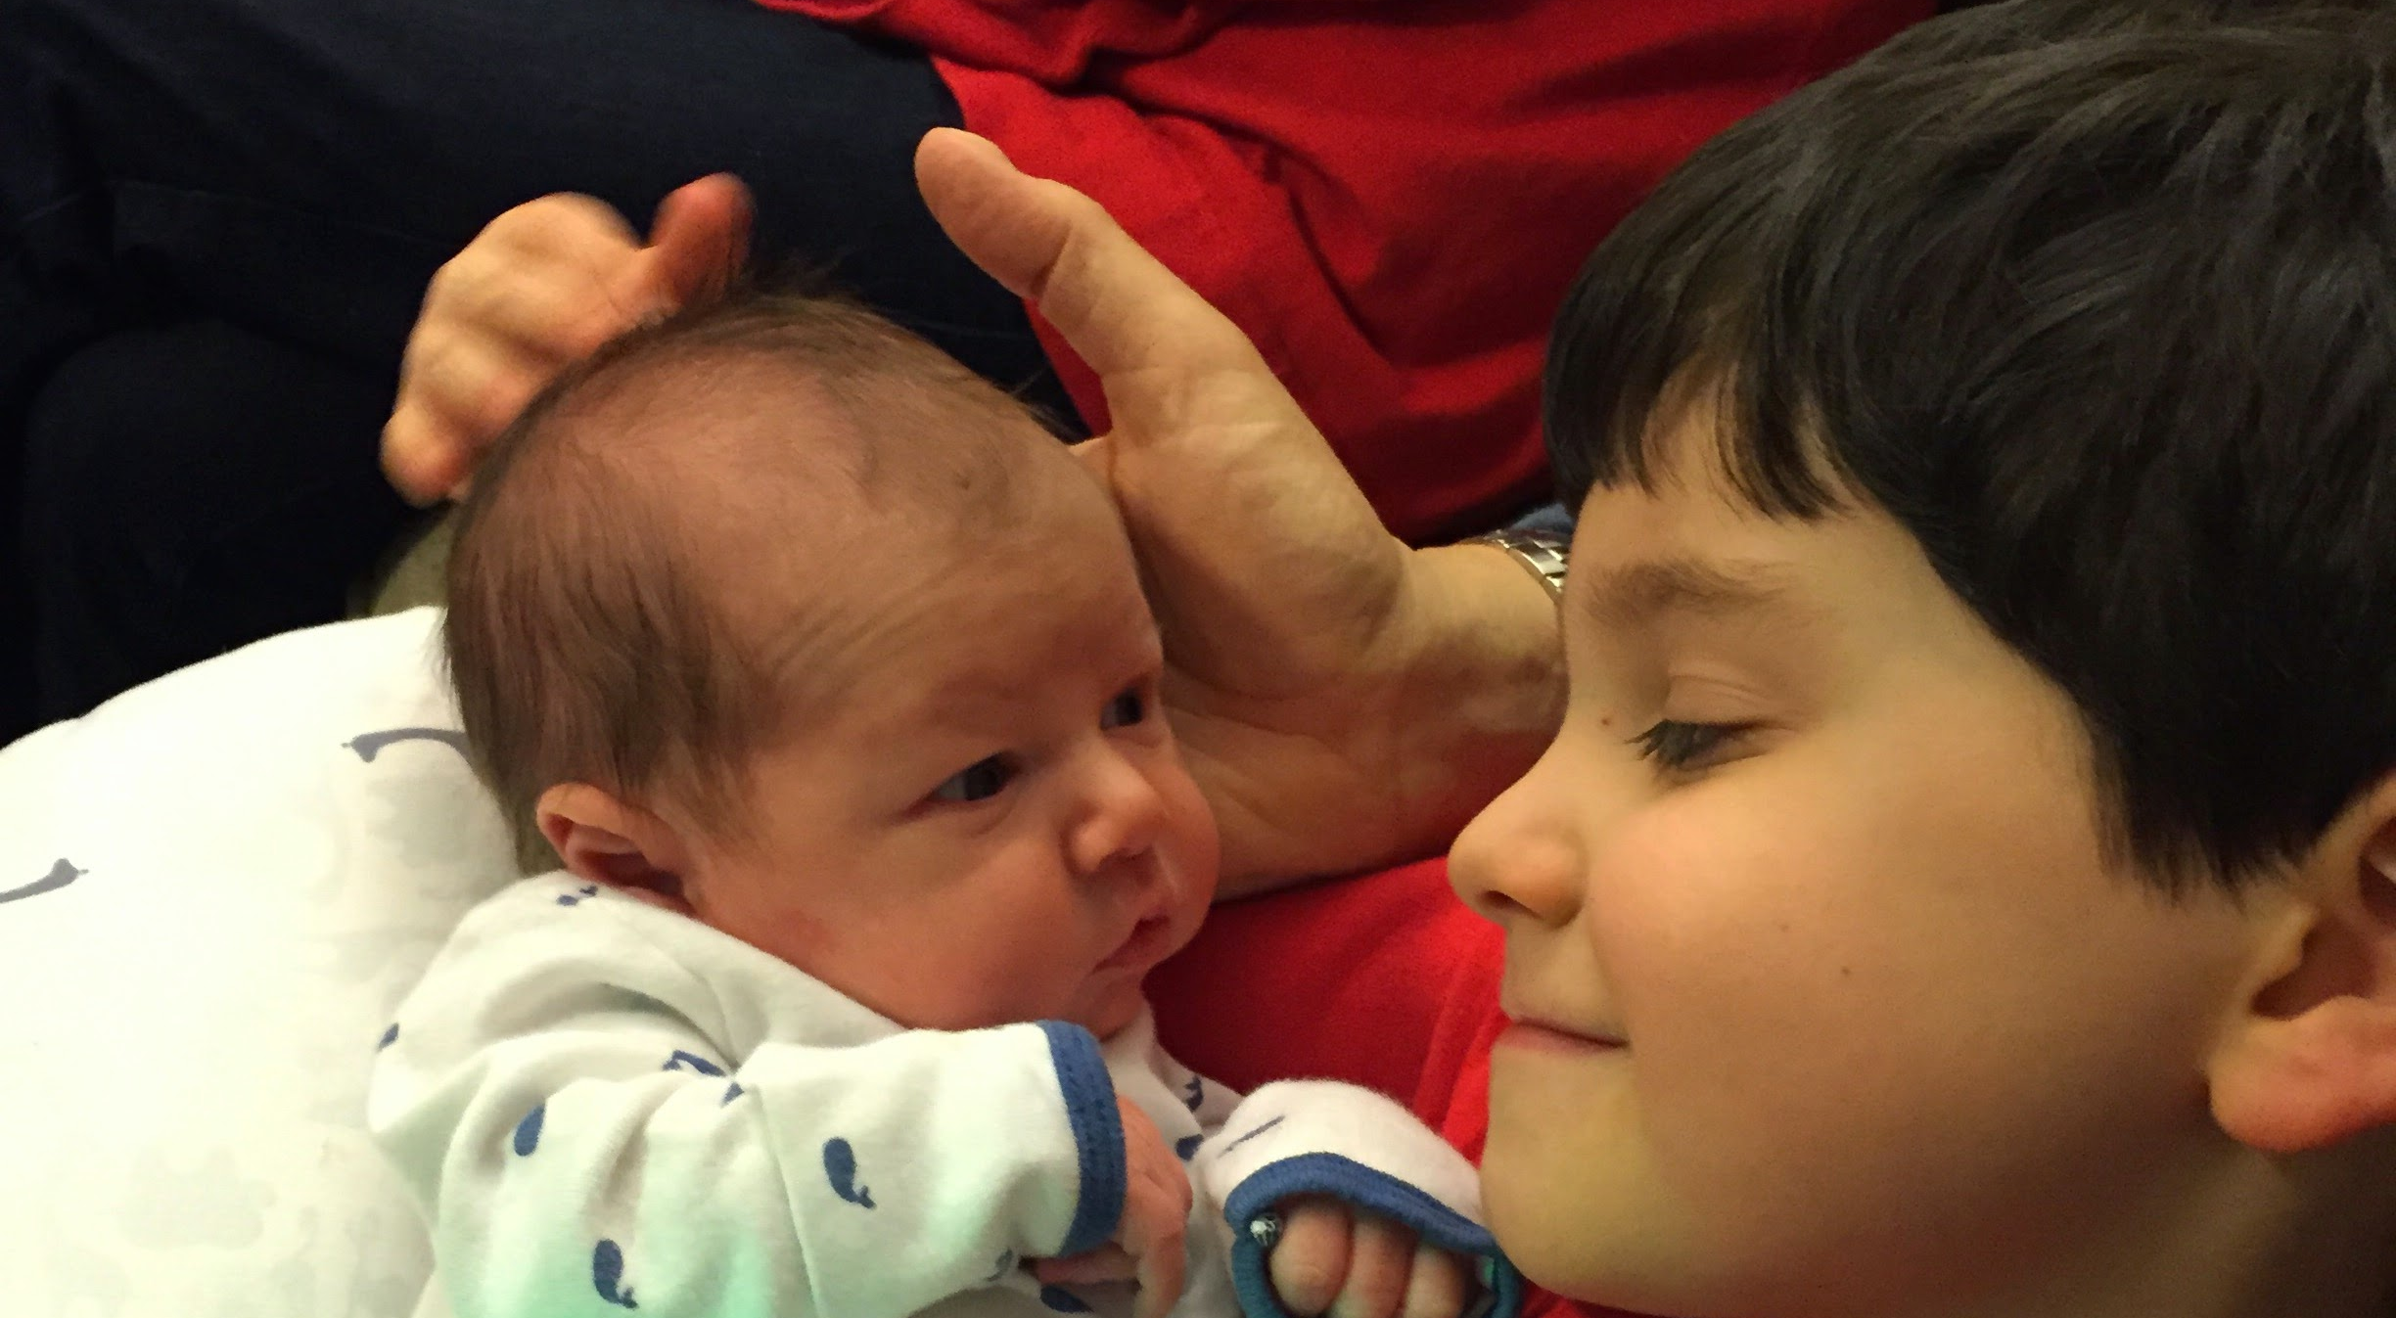
What Kind of Schools Do you Want for YOUR Grandchildren?

Slide 6
What do we know with certainty?

Slide 7
Engaged Citizenship Requires Organization and Action
Our students will inherit the instruments of democratic government, and we need them to be ready.
To be ready, they need social-emotional and character development competencies.
They also need their time in schools to provide them with opportunities to organize for meaningful social action directed at real school and community problems.
This is aligned with social studies/civics/ history/current events/school issues in the present curriculum.

Slide 8
To thrive in the 21st century, students need more than traditional academic learning. They must be adept at collaboration, communication and problem-solving, which are some of the skills developed through social and emotional learning (SEL). Coupled with mastery of traditional skills, social and emotional proficiency will equip students to succeed in the swiftly evolving digital economy.
Report of the World Economic Forum, 2016, p. 4
https://www.weforum.org/reports/new-vision-for-education-fostering-social-and-emotional-learning-through-technology

Slide 9
20 States and Counting have Adopted
SEL Competencies
Recognize one’s emotions, values, strengths, and limitations
Manage emotions and behaviors
to achieve
one’s goals
Self-awareness
Make ethical, constructive choices about personal and social behavior
Self-management
Responsible decision making
Life
Success
Social awareness
Relationship
skills
Show understanding and empathy for others
Form positive
relationships, work
in teams, deal effectively with conflict
Notes:
9

Slide 10
How Students Can Truly Achieve:
Climate, Character, and SEL Competencies
True achievement in school and in life integrates the intellectual, emotional, and social facets of learning. These are inextricably interconnected.
Habits of mind and patterns of thinking that include curiosity, explaining their reasoning, feedback process, asking questions, and defining and solving problems, and striving to communicate clearly and proudly.
Positive, Character-Building
School
Climate
Explicit
Instruction
in SEL Skills
+
+
Source: SEL and Academics: Research Brief,
Collaborative for Academic, Social and Emotional Learning, 2007.
Notes:
10

Slide 11
We Must Shift Our Focus
Preparation for College Completion“+” and Career Continuity
Ready, Willing, and Able– Savitz-Romer & Bouffard
Closing the Revolving Door– Rutgers Collaborative Center

Slide 12
Benefits of SECD
Good Science Links SECD to the Following Student Gains:
    Social-emotional skills
    Improved attitudes about self, others, and school
    Positive classroom behavior
    10-11 percentile-point gains on standardized achievement tests
And Reduced Risks for Failure:
    Conduct problems
    Aggressive behavior
    Emotional distress
Source: Durlak, J.A., Weissberg, R.P., Dymnicki, A.B., Taylor, R.D., & Schellinger, K. (2011). The Impact of Enhancing Students’ Social and Emotional Learning: A Meta-Analysis of School-Based Universal Interventions. Child Development. (available at www.casel.org) and M. Berkowitz & M. Bier, What works in character education. (Washington, DC: Character Education Partnership, 2006) (available at www.characterandcitizenship.org.)
Notes:
12
12
FIRST CLICK—SEL INCREASES STUDENT SUCCESS
SECOND CLICK—AND REDUCES RISKS FOR SCHOOL FAILURE
Many high-quality scientific studies confirm the benefits of SEL in school and in after-school programs. You can read these studies at www.casel.org. (Go to Search on the home page and enter “Positive Benefits of SEL”)
Child Development – an important, peer-reviewed journal –will publish a landmark study within the next year. The team of Joe Durlak at Loyola University, CASEL president Roger Weissberg, and graduate students from Loyola and the University of Illinois at Chicago analyzed 213 school-based studies involving 270,034 students.
In all, this rigorous scientific review of controlled experimental studies shows that, in schools that implement quality SEL programming, positive indicators went up and negative indicators went down.
SEL instruction substantially improved social-emotional skills in SEL program students compared to students in control groups.
Students’ self-esteem, connection to school, peer relationships, and classroom behavior improved.
Reading and math scores on standardized test scores were higher by 11 percentile points.
Risks of school failure decreased.
Programming reduced students’ classroom misbehavior, violence, substance use, and emotional distress.
These changes make the entire school community a better climate for academic success and positive development.

Slide 13
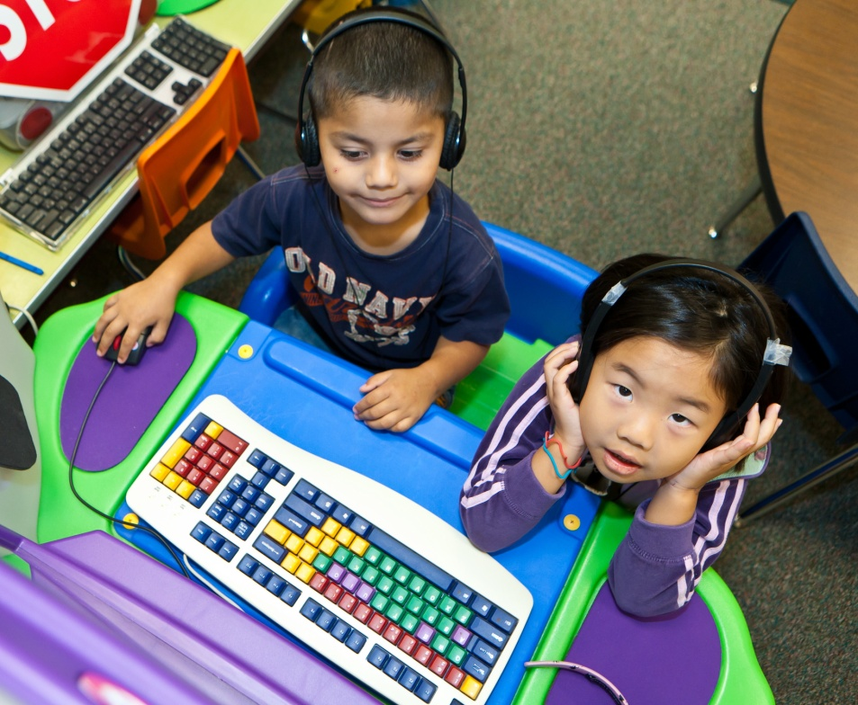
“Simply passing the accountability assessment is not enough for them to navigate this complex world”
(Metz Elementary Principal)

Slide 14
We must Turn our Jumbled Schoolhouses into Places that Synergistically Promote Social-Emotional and Character Development (SECD)
School-Wide Efforts
Character Ed
Violence
Prev
A Jumbled and Fragmented Schoolhouse
Sex Ed
Academic Skills
Families
ATOD Ed
Health Ed
Service Learning
Community Involvement
SECD
A School of Social-Emotional & Character Competence
Sex Ed
Violence
Prev
Health Ed
Academic Skills
ATOD
Ed
Service Learning
Character Ed
SCHOOL-FAMILY-COMMUNITY PARTNERSHIPS
Notes:
THEORY: How many of you have been in a school that feels like a jumbled school house? Many programs, all with goal of improving youth experience, but not working together, sometimes even working against each other! The MOSAIC process aims to address this issue through action-focused pedagogy: means toward unjumbling the jumbled school house: generalizing throughout the school day.

Slide 15
The Task is One of Ethical and Moral Responsibility and Educational Equity
It must be guaranteed for children to be in a positive school climate and to systematically learn social-emotional competencies and character virtues essential for life, college, civic, and career accomplishment. It cannot be optional.
For the future, educational equity and excellence require full preparation for the tests of life-- academic, civic, social-emotional, and character-- not mainly a life of tests.

Slide 16
SECD, Purpose, Mindset, & Social Action
Social-emotional and character development (SECD) competencies are as basic, foundational, and essential to academic achievement as reading competence.

Slide 17
SECD, Purpose, Mindset, & Social Action
Schools have a responsibility to foster SECD in schools of character that focus on supporting and actualizing students’ sense of positive purpose.

Slide 18
SECD, Purpose, Mindset, & Social Action
When students have a positive purpose and a mindset of contribution, they are willing to learn and cooperate for social action and civic participation. Their SEL skills open them to listening with empathy and respect and acting with compassion.

Slide 19
SECD, Purpose, Mindset, & Social Action
It is a primary responsibility of public schools to prepare students for citizenship in a democracy and for world-wide economic viability. We must prepare students for the tests of life, not just a life of tests.

Slide 20
We Know How to Succeed
State and National Schools of Character
State Board of Ed Resolutions for SEL
Examples of best-practices models for SEL skill development
Articulation of 11 Principles of Character
Understanding of how to assess and foster positive school climate and culture of health, safety, support, and achievement in schools
Successful, feasible, in-practice models for ongoing implementation support and continuous improvement (e.g., NJ SSN’s)

Slide 21
We Need an Integration of Social-Emotional Competence and Character
MOSAIC
Mastering Our Skills And Inspiring Character
If Skills are the propellers,
Virtues are the rudder.
The Journey of Life
requires both.

Slide 22
Positive (Noble) Purpose:
William Damon
The intention to accomplish something that is both:
Personally meaningful
In service of a greater, non-destructive good
Notes:
Our definition is based off of the work of Damon et al. (2003)
Should we call it “Noble” or “Positive” purpose??
Purposeful youth have more positive academic and social outcomes than their less purposeful peers (Bronk, Hill, Lapsley, Talib, & Finch, 2009; Damon, 2008; Hill, Edmonds, Peterson, Luyckx, & Andrews, 2016; Yeager & Bundick, 2009).

Slide 23
Trajectory of Purpose-Related Activities
Level One: The Positive Purpose of a Well-Known Individual– via picture books, fiction, biographies, documentaries, history, current events, Torah study
Level Two: The Positive Purpose of a Personally-Known Individual– local hero, community leader, clergy, first responder, family members, educators
Level Three: My Positive Purpose- Who Am I?

Slide 24
Formalizing goal-setting in school toward Positive Purpose
Set the expectation- do on a half-year or marking period basis-- 3 goals to:
Make myself better
Make my classroom better
Make my school better
Make the wider community and world better
Notes:
Transition from ice-breaker, in which people will provide intuitive ideas about what makes goals more effective, to the idea that we may not have been taught a formal goal-setting procedure
We can use the Laws of Life Contest as a way of teaching students how to set and achieve goals
We do this through establishing goal-setting contracts with students

Slide 25


Slide 26


Slide 27
RI?

Slide 28

Academy for Social-Emotional Learning in Schools: SELinSchools.org
Overarching goals are to address the gap in professional development of school leaders and diverse education professionals that exists today and to create a community for on-going mentoring, resource support, and sharing of experiences from walking the talk!
The Academy offers a two certificate programs connected to a virtual Professional Learning Community:
Certificate for School Leadership in Social-Emotional Learning and Character Development. (SELinSchools.org)
Certificate for Direct Instruction of Social-Emotional Learning and Character Development. (sel.rutgers.edu)
Academy Overview Video: http://novo.cse.edu/

Slide 29
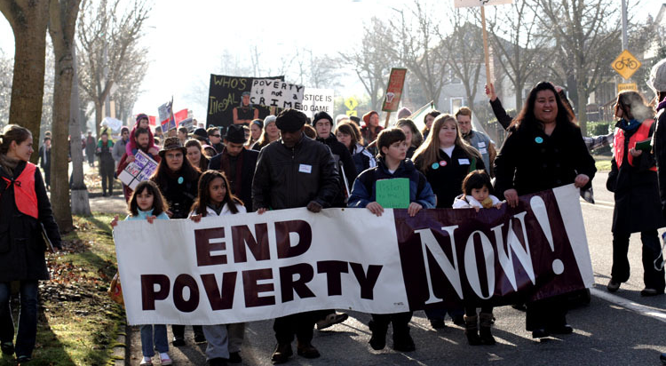
The Possibilities for Youth Action Are Greater Than We Might Realize

Slide 30
The Paths to Purpose:
Service, Inspiration, Finding a Calling
One thing I know: The only ones among you who will be really happy are those who will have sought and found how to serve.
Albert Schweitzer
It did not really matter what we expected from life, but rather what life expected of us.
Viktor Frankl
Everyone can be great because everyone can serve.
Martin Luther King, Jr.

Slide 31
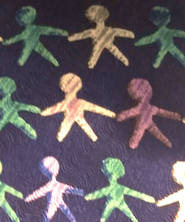
Build Social-Emotional Skills and Civility with the MOSAIC/STAT Approach
The Rutgers University Social-Emotional and Character Development (SECD) Lab just launched our new and improved website (https://www.secdlab.org/stat) for the Students Taking Action Together (STAT) initiative, also known as The Civility Project.

Slide 32
New Jersey Social Studies Standards Are Forward Looking and are More than SS Standards
Mission: Social studies education provides learners with the knowledge, skills, and perspectives needed to become active, informed citizens and contributing members of local, state, national, and global communities in the digital age.
Vision: An education in social studies fosters a population that:
Is civic minded, globally aware, and socially responsible.
Exemplifies fundamental values of American citizenship through active participation in local and global communities.
Makes informed decisions about local, state, national, and global events based on inquiry and analysis.
Considers multiple perspectives, values diversity, and promotes cultural understanding.
Recognizes the implications of an interconnected global economy.
Appreciates the global dynamics between people, places, and resources.
Utilizes emerging technologies to communicate and collaborate on career and personal matters with citizens of other world regions.

Slide 33
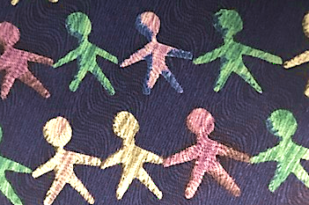
Highlights of the
MOSAIC/STAT
Approach
Increases students' perspective-taking, empathy, problem solving, communication, emotion regulation, and civic engagement
Works within existing content for history, current events, and school-related issues
Amplifies student voice and empowerment
Opens a pathway to greater participation in the civic life of schools and communities
Meets national and state social studies instruction standards

Slide 34

Small Steps Toward a
Great Journey:
How Shall We Proceed to Get to Where We Know We Must Go?

Slide 35
Courageous Leadership Needed
To look into the future with realism and commitment in a short-term political environment requires courage.
To change course requires courage
To provide the structural, budget, and personnel supports needed requires courage

Slide 36
Courageous Leadership Needed
For adults to model the changes at the Board level, in the district office, and in all school-related services areas requires courage.
To move to an orientation of communities of learners in a spirit of continuous improvement, with no fear of data, and to see one-another as resources with untapped positive potential acting as rainbows in students’ and colleagues’ clouds requires courage.

Slide 37
Contact Information
Maurice J. Elias, Ph.D. , Rutgers University
Director, Rutgers Social-Emotional and Character Development Lab and The MOSAIC Project
(www.secdlab.org, sel.rutgers.edu)
Co-Director, Academy for Social-Emotional Learning (SELinSchools.org)
Maurice.Elias@rutgers.edu and www.edutopia.org/profile/maurice-j-elias

